Slide 1
Scrum for Students - FYP
Bilal Shahzad

Slide 2
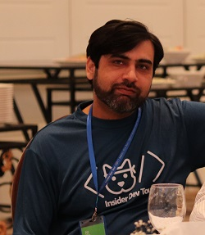
Trainer
Bilal Shahzad
Agilist/Architect/Teacher/Blogger/YouTuber
17+ Years of Professional Experience
MVP (Microsoft Most Valuable Professional)
MCT (Microsoft Certified Trainer)

Slide 3
How to Contact
https://www.linkedin.com/in/bilalshahzad139/
https://www.facebook.com/LearningInUrduCentre/
https://www.youtube.com/c/LearnInUrdu139
http://learninginurdu.pk
@bilalshahzad

Slide 4
Agenda
Waterfall Model
Issues with Waterfall Model
What is Agile Software Development
Wat is Scrum
Scrum Team
Scrum Events
Scrum Artifacts
FYP using Scrum
Q&A

Slide 5
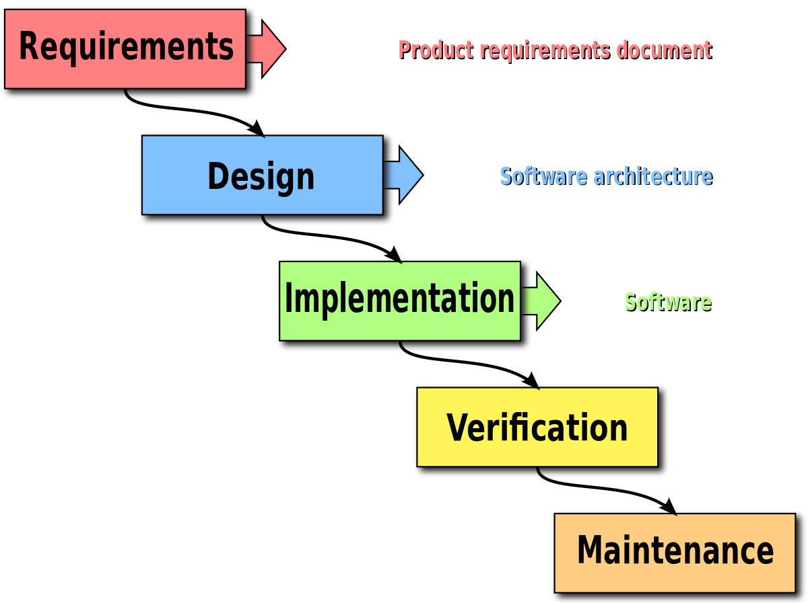
Waterfall Model
Notes:
Ref: Wiki pedia

Slide 6
Some Issues of Waterfall approach
Waterfall approach becomes problematic in most of the projects due to
Freezing nature
Less or no feedback from end stakeholders during implementation
Dynamics of business can change and existing requirements can become stale

Slide 7
Roles
Software Developer
Quality Assurance Engineer
Graphics Designer
Team Lead
Database Developer
Business Analyst
Content Writer
Deployment Engineer
And many more…

Slide 8
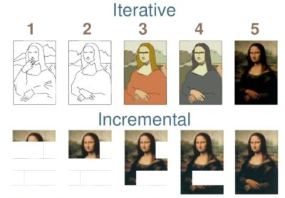
Iterative vs. Incremental
Notes:
https://agilenotion.com/wp-content/uploads/2019/03/iterativeIncrementalEvolutionary-e1551463399277.jpg

Slide 9
Agile Manifesto
Individuals and interactions over processes and tools
Working software over comprehensive documentation
Customer collaboration over contract negotiation
Responding to change over following a plan

Slide 10
Agile Methodologies/Frameworks
Scrum
eXtreme Programming (XP)
Feature Driven Development
Lean Software Development
Kanban
And many others…

Slide 11
SCRUM Framework
Ken Schwaber and Jeff Sutherland introduced Scrum in 1995 after using it in industry for many years.
Agile based Framework
Iterative & Incremental
Based on Empiricism => Learn from Experiences
Gives Freedom to every stakeholders

Slide 12
SCRUM Framework
Short Cycles/Iterations
Fast feedback
Continuous improvement
Inspection & Adaption
Rapid adaptation to change
Accelerated delivery

Slide 13
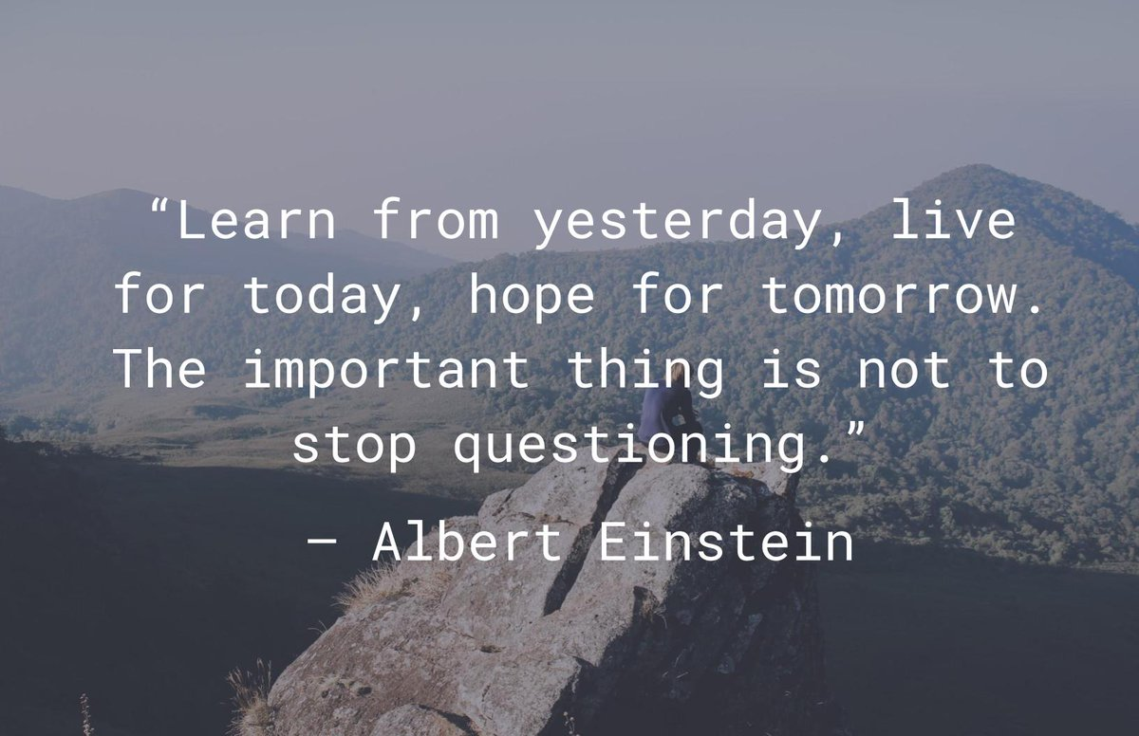
Inspect & Adopt

Slide 14
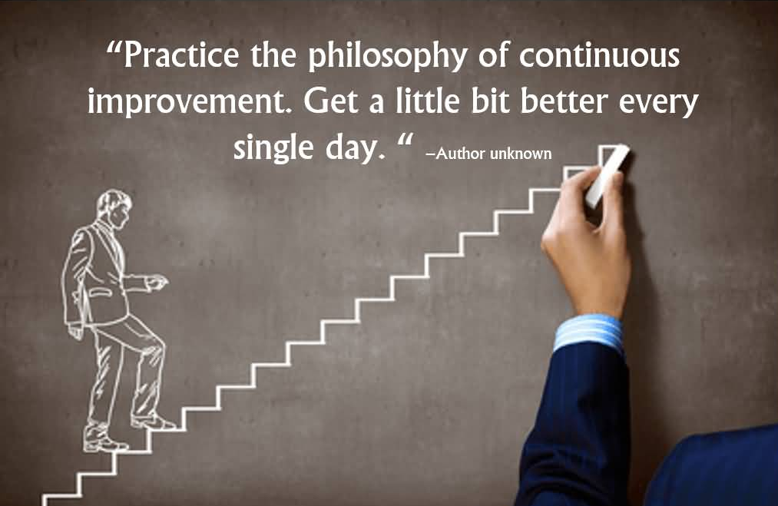
Continuous Improvement
Notes:
https://www.askideas.com/wp-content/uploads/2016/11/Practice-the-philosophy-of-continuous-improvement.-Get-a-little-bit-better-every-single-day.-2.jpg

Slide 15
The SCRUM Team
Roles
Scrum Master
The Development Team
Product Owner
Self-Organizing
Cross-Functional
Co-Located
Live interaction instead of calls or emails

Slide 16
The SCRUM Team – Cross Functional
A cross-functional team is a group of people with different functional expertise working toward a common goal. It may include people from finance, marketing, operations, and human resources departments. (Ref: Wikipedia)

Slide 17
The SCRUM Team – Self-Organizing
Freedom to make decisions
Freedom to experiment
Freedom to choose how to produce More VALUE in Less time.
Freedom to work according to their capacity
Freedom to take initiatives
No deadline pressure from outside of team
No Lead or Manager in it

Slide 18
SCRUM Events
Time boxed events
The heart of Scrum is a Sprint
(4 weeks or less)
Sprint Planning
Daily Scrum (meeting)
15 Minutes
Sprint Review
Sprint Retrospective
Sprint Refinement

Slide 19
SCRUM Artifacts
Product Backlog
User Story
Sprint Backlog
Increment
Potentially deployable work

Slide 20
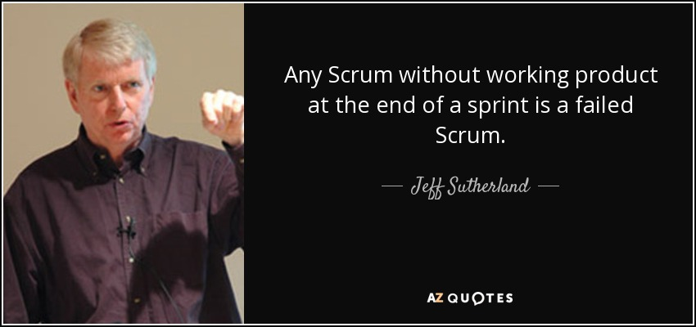
Progress in Scrum

Slide 21
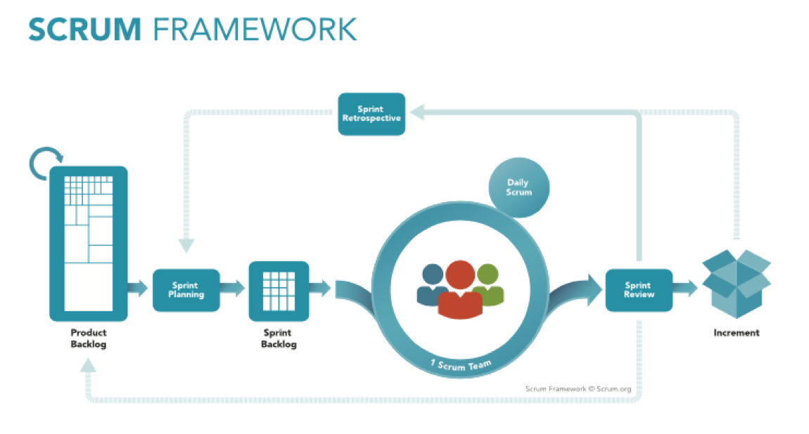

Slide 22
FYP using SCRUM?
Sprint 0
One Week
List down all requirements you can think about your project.
Create basic DB schema
Explore if there are Open source (Full or Partial) solutions available similar to your project.
Make sure all team members own this project after this Sprint

Slide 23
FYP and SCRUM
Sprint 1 and onwards
4 Weeks
Assume You have only this One Month to complete whatever you can do.
Assume You are responsible for everything.
Consider this as You are doing Job somewhere.
You (Team) will do everything. You will do development, QA, Graphics, DB part etc.
You need to provide a deployable/shippable thing after the sprint completed from every perspective.

Slide 24
FYP using SCRUM?
Day 1: Sprint Planning
Team needs to pick & decide what team can deliver in one month.
Pick items based on “the most valuable” from end user perspective.
Think, Brainstorm on every picked requirement. Create Rough Mockups if required. Write Important point in your ‘user story’ if required.
Add technical detail/decision from planning
Define one liner ‘Sprint Goal’

Slide 25
FYP and SCRUM
Every Day during Sprint
Daily Scrum Meeting (Planning)
Every Team Member inspect her progress and update her future plan (adopt)
What did she plan yesterday. How did that plan go. What is done so far. What is pending.
What is her plan for next 24h.
Any issue/impediment faced
Team will be doing refinements of backlog during sprint according to their ease.

Slide 26
FYP and SCRUM
Last Day of Sprint
Sprint Review: Team will show fully completed items to stack holders and get their feedback. Based on feedback, new items will be created in backlog.
Sprint Retrospective: Team meets together and introspect whole sprint. What was good. What was bad. Based on experiences, team pick some improvement points (adopt)
Next day? New Sprint starts

Slide 27
Questions
Will there be any Team Lead?
No
Who will assign tasks to team members?
No One. Anyone can pick any task.
Who will be responsible if some items are not completed or there are bugs.
Whole Team
Who will be Scrum Master in our case?
Anyone from Team can take this responsibility but you may ignore it for now.

Slide 28
Questions
Who will be Product Owner
You & Your Supervisors
What if we don’t know some technology?
Learn that during sprint. Create tasks for it.
What if we are not aware about our next requirements?
Explore it during sprint and create backlog.
What if I didn’t do anything, Do I still need to attend DSM?
Yes, You need to still inspect your progress and share what happened.

Slide 29
Questions
Do all members need to do programming?
No, do what you best can do. If you all are Full Stack Developers, That is best combination.
When we’ll deploy our sprint work on Server/Cloud for review?
Everything including QA, documentation, deployment etc. should be completed within sprint.

Slide 30
Questions
What should we do as we may have study assignments & quizzes?
You as Team need to Self-Organize and see how you can work together to achieve the Goal.
How can we know how much we can do?
You use your best guess/experience. And then daily you inspect & learn. Then at the end, you inspect & learn. With every day, you should know more about yourself & your team capacity. Every sprint estimations should be better than previous sprints.

Slide 31
Questions
We are going to have research project, should we still use Scrum framework?
Yes, It is best for such type of work where you don’t have much detail. You explore & produce work for future.
How can we increase our productivity?
Automate anything/everything you can. Keep any eye on your tasks and see what can be automated. Learn it. Automate it. Save your time => Spend more time on “Valuable” items.

Slide 32
Questions
Do we need to log our hours somewhere?
Yes, for your own experience/tracking.
Can we use any tools (e.g. Slack, Skype, Zoom, JIRA) to increase our collaboration?
Why not. Use whatever you need to increase productivity & achieve the goal.
When should we contact with Supervisor if we face any issue?
First as a Team, You should try to solve that problem. Again “Team”. Once team feels that It is creating impediment & blocking work, team should get relevant guidance (from supervisor or from relevant person)

Slide 33
Questions
University follows Waterfall approach and first we need to submit different documentations before actually working on code. Where will Scrum come in this?
If your university is not enforcing you to follow Scrum, still you can use Scrum inside your team. If any item is required by University, you can add that item in your sprint backlog and work on it as you will work on your project. Again, this is my suggestion. Use your common sense to solve this issue. End Goal => High productivity with or without Scrum.

Slide 34
Questions
In DSM, do we share our status to Supervisor?
No, It is an inspection activity. You need to inspect your progress and share with other team members.
Can we make decisions by ourselves?
Yes, “Freedom”. But you are accountable too.
What if we make mistakes?
Yes, You will. No issue in making mistakes. Issue is if you don’t learn from mistakes & repeat again.
Where should we create our backlog or sprint backlog?
You may create that even in some google online sheet. But you may also use free version of JIRA to manage your items. + You may use Github issues feature.

Slide 35


Last but not the least

Slide 36
Feedback Form
https://docs.google.com/forms/d/e/1FAIpQLSeM3q8_zAuE99lqYa-jXdvZEQKNUkSrGGBWfY8J9b9YBtTCWw/viewform

Slide 37


Slide 38
What is Next?
Introduction to Github & Gitflow for Students – FYP
Introduction to JIRA for Students - FYP

Slide 39
How to Contact
https://www.linkedin.com/in/bilalshahzad139/
https://www.facebook.com/LearningInUrduCentre/
https://www.youtube.com/c/LearnInUrdu139
http://learninginurdu.pk
@bilalshahzad

Slide 40
Thank You

